Slide 1
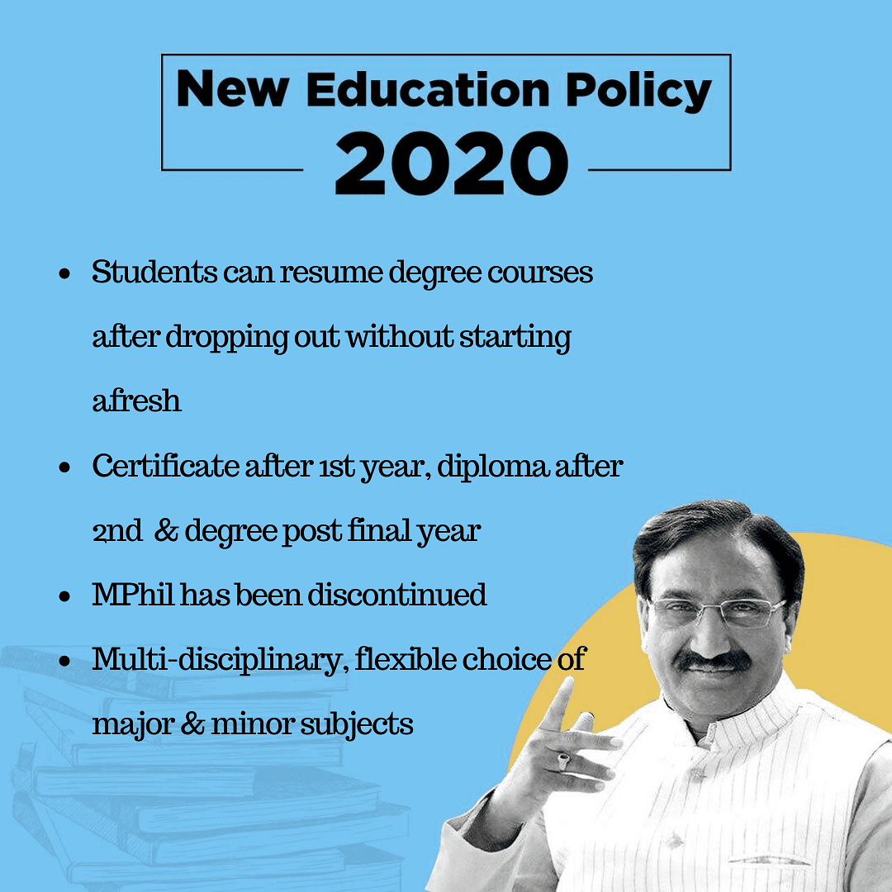
New Education Policy
2020
What Is it series ?
हिंदी में
HISTORY
HINDI

Slide 2
Previous Education Policies
1968- 1st Education Policy – Indira Gandhi
1986- 2nd Education Policy- Rajiv Gandhi
1992- Modified 2nd Education Policy PV Narasimha Rao
2009- Right to Education Article 21 A(6-14 year free and compulsory education)- Manmohan Singh
2020-3rd Education Policy Narendra Modi

Slide 3
Committee Recommendations
Former ISRO chief Dr. Kasturirangan lead 9 member committee drafted NEP 2019 which became NEP 2020
Education comes under concurrent list so recommendation in NEP 2020 is not mandatory to states

Slide 4
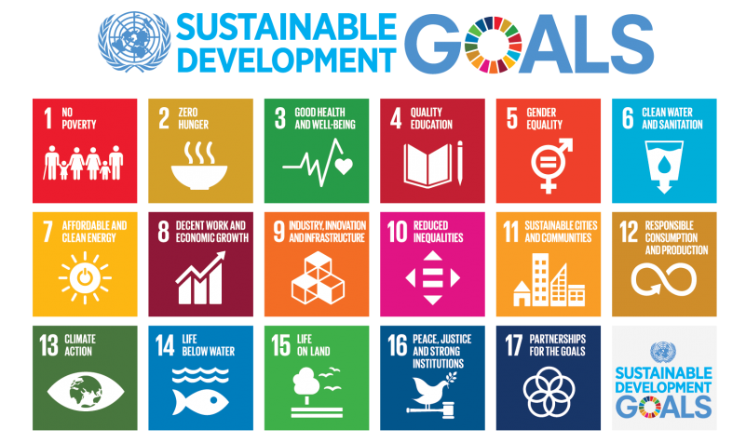
Why New Education Policy Required ?
India adopted SDG goals in 2015
By 2030 India seek to ensure inclusive and quality education and promote lifelong learning opportunities for all

Slide 5
Why New Education Policy Required ?
The survey titled "National Employability report engineers annual report 2019“ said Approximately 80 percent of Indian engineering graduates are not employable in the current knowledge

Slide 6
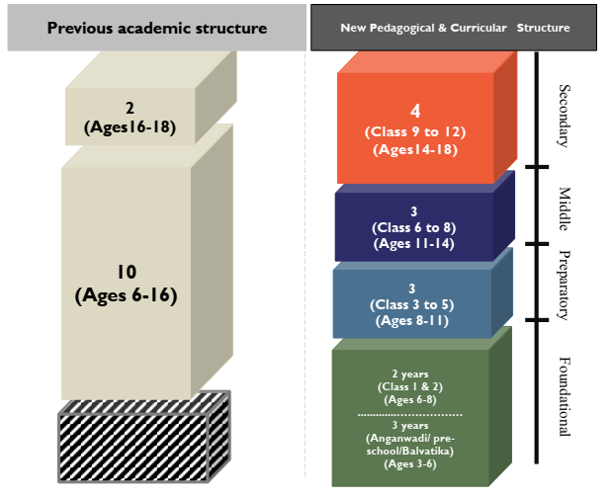
Earlier 10+2 structure
NEP 2020 brings
5+3+3+4
structure
NEP 2020 brings first 3 year in formal education

Slide 7
Changes in School Education
Upto 5 th grade education should be in Mother tongue
Report Card will be comprehensive based on SKILL+ CAPABILITIES
Student to learn coding from class 6
NEP 2020 aim to achieve universal foundation literacy and numeracy in primary education by 2025

Slide 8
Changes in Higher Education
Replacing UGC and AICTE with Higher Education Commission of India (HECE)- single regulator ( excluding Medical an Law)
Introduction of 4 year multidisciplinary bachelor’s Programme with multiple Exit Options
Discontinuation of MPHIL
Degree
MA
MPHIL
PHD
BEFORE
Degree
MA
PHD
AFTER

Slide 9
Aspect | Before NEP 2020 (3-Year Degree) | 3-Year Degree (After NEP 2020) | 4-Year Degree (After NEP 2020)
Exit Option | Not Available (Available only for five-year Integrated Courses) | Available after 1st year, Second-Year | Available after 1st, 2nd and 3rd year
Award of Degree | Mandatory to complete the full duration of the programme | Candidates who wish to exit after the 1st year will be awarded a Certificate in the field of study Candidates who wish to exit after the 2nd year will be awarded a Diploma in the field of study Candidates who complete the three-years course will be awarded a degree. | Candidates who wish to continue after the 3rd year can specialize in a different field apart from the mandatory major or minor. Exit options will be applicable at par with three-year degree courses.
Scope of Research | Minimal | Candidates who do not wish to continue with 4th year will have to complete the research project in the 2nd-year of Master’s programme (applicable only for those students who opt for Master’s). | Candidates who complete 4-year degree courses will also get ‘Degree with Research’ if he/ she completes rigorous research specified by the Higher Education institute.

Slide 10
Change in Master Degree
Type of Course | Eligibility | Course Details
Type 1 – 2-Year Master’s Course | Candidates who have completed a three-year Bachelor’s degree are eligible | The second year of the course will be devoted to the research project and it is mandatory to complete the same.
Type 2 – 1-Year Master’s Degree Course | Candidates who have completed 4-year Bachelor’s degree programme with Research | Research is not mandatory for a 1-year course, as students already complete their research project in a four-year Bachelor’s degree.

Slide 11
Changes in Higher Education
Setup of National Research Foundation to increase research culture
Higher Education open up for foreign universities, government will make law so that they can setup their campus in INDIA
Setup MERU (Multidisciplinary Education and Research Universities)
Academic Bank of Credits
Interdisciplinary combination of subjects

Slide 12
Changes in Higher Education- Board Exam
10th and 12th Board exams are there
Second chance at board exam to improve score
Board exam will offer level of exam for different subject
Flexibility to choose subject
Student have to choose subject from 9th class (previously student choose subject in 11th class)
Vocational subject given same weightage

Slide 13
Changes in Higher Education
National Curricular Framework for school education with help of NCERT will be made (NCFSE 2020-21)
Single stream institute to become multidisciplinary by 2040
Common entrance Exam (CEE) for universties admission by National Testing Agency
CEE will be conducted at least two time in one year

Slide 14
NEP 2020- Teachers
Student- Teacher ratio aim to be 30:1
High quality resource for teacher on DIKSHA portal
4 year integrated B.ED Degree minimum to become teacher

